Slide 1
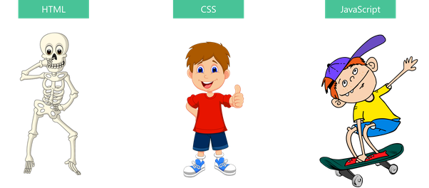
Noida Institute of Engineering and Technology, Greater Noida

Slide 2
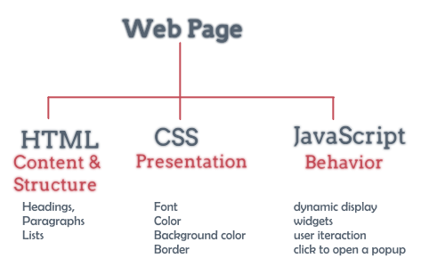
Noida Institute of Engineering and Technology, Greater Noida

Slide 3
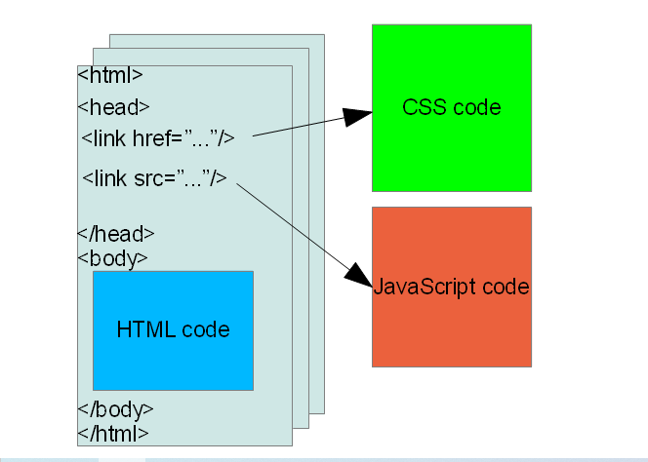
Basic structure of HTML documents

Slide 4
1. Introduction to HTML
HTML is a language used for describing web pages:
HTML stands for Hyper Text Markup Languages
HTML is not a programing language, it is a markup language
HTML Tags
HTML tags are keywords surrounding by angle brackets like <HTML>.
HTML tags normally come in pairs like <b> and <\b>.
The first tag is start tag and second tag is the end tag.
Start and end tags are also called opening tags and closing tags.

Slide 5
HTML Paragraphs
HTML paragraphs:
The HTML <p> element defines a paragraph.
Example:
Output:
<!DOCTYPE html>
<html>
<body>
<p>This is a paragraph.</p>
<p>This is a paragraph.</p>
<p>This is a paragraph.</p>
</body>
</html>
This is a paragraph.
This is a paragraph.
This is a paragraph.

Slide 6
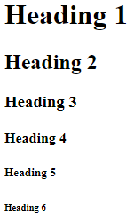
HTML Headings
HTML headings:
HTML headings are titles or subtitles that you want to display on a webpage.
HTML headings are defined with the <h1> to <h6>
Example:
Output:
<!DOCTYPE html>
<html>
<body>
<h1>Heading 1</h1>
<h2>Heading 2</h2>
<h3>Heading 3</h3>
<h4>Heading 4</h4>
<h5>Heading 5</h5>
<h6>Heading 6</h6>
</body>
</html>

Slide 7

4. HTML TABLES
HTML TABLES:- HTML tables allow web developers to arrange data into rows and columns.
Each table cell is defined by a <td> tag , <th> tag and <tr> tag.
Example:
<!DOCTYPE html>
<html>
<style>
table, th, td { border:1px solid black; }</style>
<body>
<table style="width:100%">
<tr>
<th>Person 1</th>
<th>Person 2</th>
</tr>
<tr>
<td>Emil</td>
<td>Tobias</td>
</tr>
<tr><td>16</td> <td>14</td></tr> </table></body></html>
Output:

Slide 8
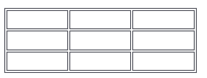
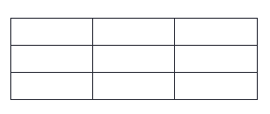
HTML Tables border
To add a border, use the CSS border property on table , th and td elements.
Solid border Example: 1
Collapsed Table Borders Example: 2
table, th, td {
border: 1px solid black;
border-collapse: collapse;
}
table, th, td {
border: 1px solid black;
}

Slide 9
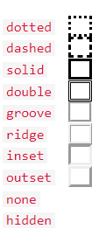
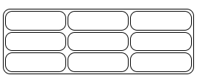
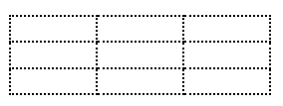
HTML Tables border
To add a border, use the CSS border property on table , th and td elements.
Round border Example: 3
Dotted Borders Example: 4
table, th, td {
border: 1px solid black;
border-radius: 10px;
}
th, td {
border-style: dotted;
}

Slide 10
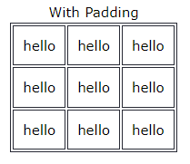
HTML Table Padding & Spacing
Cell padding is the space between the cell edges and the cell content. By default the padding is set to 0. To add padding on table cells, use the CSS padding property.
Example:
th, td {
padding-top: 10px;
padding-bottom: 20px;
padding-left: 30px;
padding-right: 40px;
}

Slide 11
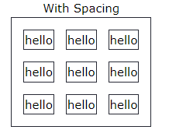
HTML Table Padding & Spacing
Cell spacing is the space between each cell. By default the space is set to 2 pixels.
To change the space between table cells, use the CSS border-spacing property.
Example:
table { border-spacing: 30px; }

Slide 12

HTML Table Colspan & Rowspan
<style>
table, th, td {
border: 1px solid black;
border-collapse: collapse;}
</style>
</head>
<body>
<tr>
<th colspan="2">Name</th>
<th>Age</th>
</tr>
<tr>
<td>Jill</td>
<td>Smith</td>
<td>43</td>
</tr>
<tr>
<td>Eve</td>
<td>Jackson</td>
<td>57</td>
</tr></table> </body> </html>
Example:
Output:

Slide 13
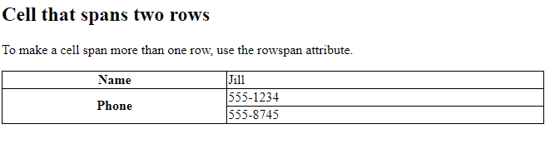
HTML Table Colspan & Rowspan
<table> <tr> <th>Name</th> <td>Jill</td> </tr> <tr> <th rowspan="2">Phone</th> <td>555-1234</td> </tr> <tr> <td>555-8745</td> </tr> </table>
Example:
Output:

Slide 14
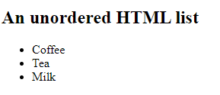
5. HTML Lists
HTML lists allow web developers to group a set of related items in lists.
Unordered HTML List
Ordered HTML List
Example:
Output:
<!DOCTYPE html>
<html>
<body
<h2>An unordered HTML list</h2>
<ul>
<li>Coffee</li>
<li>Tea</li>
<li>Milk</li>
</ul>
</body>
</html>

Slide 15
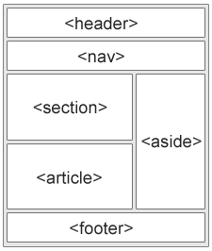

2. New semantic element in HTML5
A semantic element clearly describes its meaning to both the browser and the developer.
Examples of semantic elements: <section> , <aside> ,<article> etc.
1. HTML <section> Element
Example:
<!DOCTYPE html>
<html>
<body>
<section>
<h1>WWF</h1>
<p>The World Wide Fund for Nature (WWF)...... WWF was founded in 1961.</p>
</section>
</body>
</html>
Output:

Slide 16
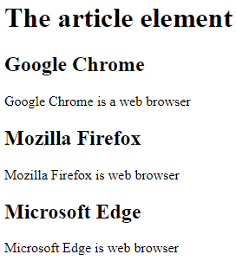
New semantic element in HTML5
Example of where the <article> element are used.
ex- Forum posts , Blog post , User comments, Product cards, Newspaper articles
2. HTML <article> Element
Example:
Output:
<!DOCTYPE html>
<html>
<body>
<h1>The article element</h1>
<article>
<h2>Google Chrome</h2>
<p>Google Chrome is a web browser</p></article>
<article>
<h2>Mozilla Firefox</h2>
<p>Mozilla Firefox is web browser</p></article>
<article>
<h2>Microsoft Edge</h2>
<p>Microsoft Edge is web browser</p></article>
</body>
</html>

Slide 17

New semantic element in HTML5
Example of where the <footer> element are used.
ex- Copyright information ,contact information ,Product cards, email.
3. HTML <footer> Element
Example:
Output:
<!DOCTYPE html>
<html>
<body>
<footer>
<p>Author: Hege Refsnes</p>
<p><a href="mailto:hege@example.com">hege@example.com</a></p>
</footer>
</body>
</html>

Slide 18

New semantic element in HTML5
The <nav> element defines a set of navigation links.
4. HTML <nav> Element
Example:
Output:
<!DOCTYPE html>
<html>
<body>
<nav>
<a href="/html/">HTML</a> |
<a href="/css/">CSS</a> |
<a href="/js/">JavaScript</a> |
<a href="/jquery/">jQuery</a>
</nav>
</body>
</html>

Slide 19
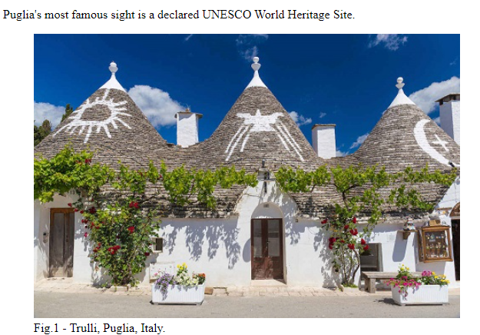
New semantic element in HTML5
HTML <figure> and <figcaption> Elements.
Example:
Output:
<!DOCTYPE html>
<html>
<body>
<p>Puglia's most famous sight is a declared UNESCO World Heritage Site.</p>
<figure>
<img src="pic_trulli.jpg" alt="Trulli" style="width:100%">
<figcaption>Fig.1 - Trulli, Puglia, Italy.</figcaption>
</figure>
</body>
</html>

Slide 20
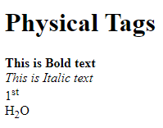
3.physical/logical character effects.
Physical Tags are used in HTML to provide actual physical formatting to the text.
Physical tags commonly used in HTML are:- <b>,<i>,<sup>,<sub>,etc.
Example:
Output:
<!DOCTYPE html>
<html>
<body>
<h1> Physical Tags </h1>
<b> This is Bold text </b> <br>
<i> This is Italic text </i> <br>
1<sup>st </sup> <br>
H<sub>2</sub>O <br>
</body>
</html>

Slide 21
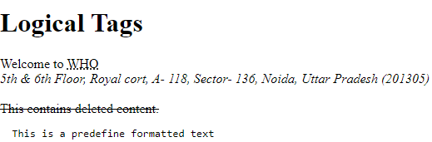
3.physical/logical character effects.
Logical Tags are used in HTML to display the text according to the logical styles.
Ex:- <abbr> , <address> , <del> , <pre> , etc.
Example:
<!DOCTYPE html>
<html>
<body>
<h1> Logical Tags </h1>
Welcome to <abbr title=“World health organization"> WHO</abbr> <br>
<address> 5th & 6th Floor, Royal cort, A- 118, Sector- 136, Noida,
Uttar Pradesh (201305) </address> <br>
<del> This contains deleted content. </del>
<pre> This is a predefine formatted text </pre>
</body>
</html>
Output:

Slide 22
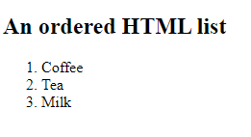
HTML Lists
HTML lists allow web developers to group a set of related items in lists.
Unordered HTML List
Ordered HTML List
Example:
Output:
<!DOCTYPE html>
<html>
<body>
<h2>An ordered HTML list</h2>
<ol>
<li>Coffee</li>
<li>Tea</li>
<li>Milk</li>
</ol>
</body>
</html>

Slide 23
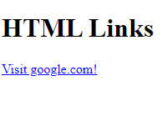
6. Working with links
HTML links are hyperlinks. You can click on a link and jump to another document. Links allow users to click their way from page to page.
HTML Links – Syntax : <a href="url">link text</a>
Example:
Output:
<!DOCTYPE html>
<html>
<body>
<h1>HTML Links</h1>
<p><a href="https://www.google.com/">Visit google.com!</a></p>
</body>
</html>

Slide 24
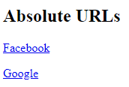
Types of links
Absolute URLs
Relative URLs
Example:
Output:
<!DOCTYPE html>
<html>
<body>
<h2>Absolute URLs</h2>
<p><a href="https://www.facebook.com/">Facebook</a></p>
<p><a href="https://www.google.com/">Google</a></p>

Slide 25
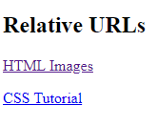
Types of links
Absolute URLs
Relative URLs
Example:
Output:
<!DOCTYPE html>
<html>
<body>
<h2>Relative URLs</h2>
<p><a href="html_images.asp">HTML Images</a></p>
<p><a href="/css/default.asp">CSS Tutorial</a></p>
</body>
</html>

Slide 26

Use of links in list
Example:
Output:
<!DOCTYPE html>
<html>
<body>
<ul>
<li><a href="#">Link 1</a></li>
<li><a href="#">Link 2</a></li>
</ul>
</body>
</html>

Slide 27
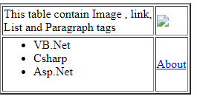
Use of links in tables
Example:
<html>
<body >
<table>
<td>
<ul>
<li>VB.Net</li>
<li>Csharp</li>
<li>Asp.Net</li>
</ul>
</td>
<td>
<a href="www.mywebsite.com/about.html">About</a>
</td>
</table>
</body>
</html>
Output:

Slide 28
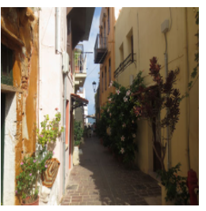
Image Handling
Example:
<!DOCTYPE html>
<html>
<body>
<h2>HTML Image handling</h2>
<img src="img_chania.jpg" alt="Flowers in Chania" width="250" height="250">
</body>
</html>
Output:

Slide 29
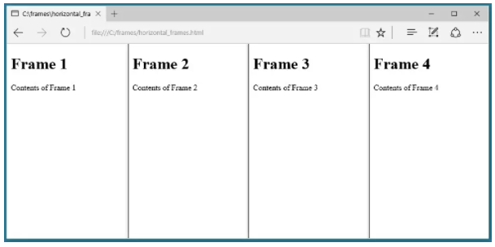
HTML FRAMES
HTML frames are used to divide your browser window into multiple sections where each section can load a separate HTML document. A collection of frames in the browser window is known as a frameset. The window is divided into frames in a similar way the tables are organized: into rows and columns.
Example of Creating Vertical Columns
<!DOCTYPE html>
<html>
<frameset cols="*,*,*,*">
<frame src="../file path/frame_1.html">
<frame src="frame_2.html">
<frame src="frame_3.html">
<frame src="frame_4.html">
</frameset>
</html>
Output:

Slide 30
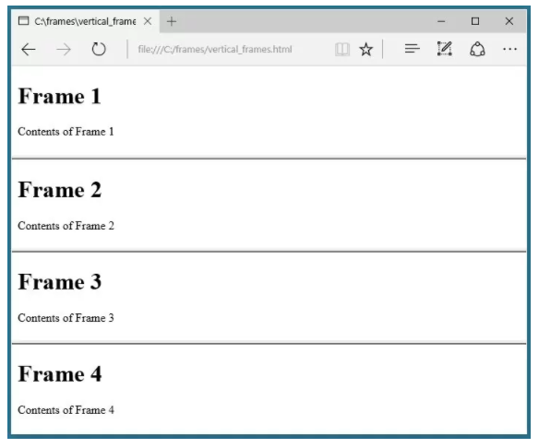
HTML FRAMES
Example of Creating Horizontal Rows:
Output:
<!DOCTYPE html>
<html>
<frameset rows="*,*,*,*">
<frame src="frame_1.html">
<frame src="frame_2.html">
<frame src="frame_3.html">
<frame src="frame_4.html">
</frameset>
</html>

Slide 31
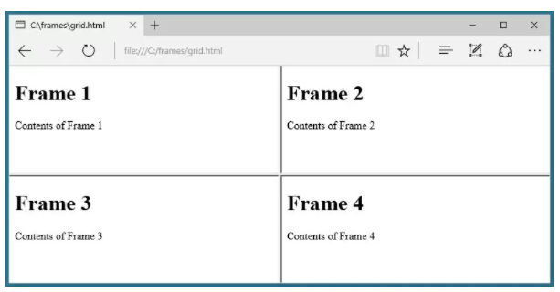
HTML FRAMES
Example of Mixing Columns and Rows
Output:
<frameset rows="*,*" cols="*,*">
<frame src="frame_1.html">
<frame src="frame_2.html">
<frame src="frame_3.html">
<frame src="frame_4.html">
</frameset>

Slide 32
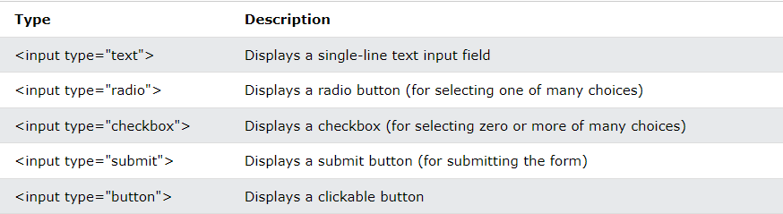
HTML FORMS
An HTML form is used to collect user input. The user input is most often sent to a server for processing.
The HTML <form> element is used to create an HTML form for user input.
The <form> element is a container for different types of input elements.

Slide 33
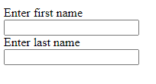
Single-line Input field for text input.
The <input type="text"> defines a single-line input field for text input.
Example:
Output:
<form>
<label>Enter first name</label><br>
<input type="text"><br>
<label>Enter last name</label><br>
<input type="text’’><br>
</form>

Slide 34
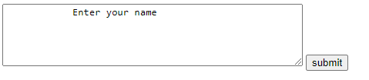
HTML <text area> Tag.
The <text area> tag defines a multi-line text input control. A text area can hold an unlimited number of characters
Example:
Output:
<!DOCTYPE html>
<html>
<head>
<title>HTML textarea Tag</title>
</head
<body>
<textarea rows = "5" cols = "50" name = "description">
Enter your name
</textarea>
</form>
</body>
</html>

Slide 35
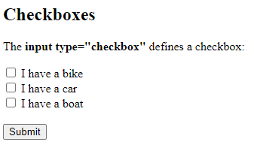
HTML <Checkboxes> Tag.
The <input type = “Checkbox”> tag Checkboxes let a user select ZERO or MORE options of a limited number of choices.
Example:
Output:
<form>
<input type="checkbox" id="item1" name="item1" value="Item 1">
<label for="item1"> Item 1</label><br>
<input type="checkbox" id="item2" name="item2" value="Item 2">
<label for="item2"> Item 2</label><br></form>

Slide 36
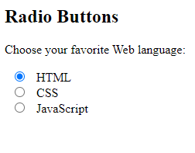
HTML <Radio Buttons> Tag.
The <input type = “radio”> defines a radio button. Radio buttons let a user select ONE of a limited number of choices.
Example:
Output:
<form>
<input type="radio" id="html">
<label for="html">HTML</label><br>
<input type="radio" id="css" >
<label for="css">CSS</label><br>
<input type="radio" id="javascript">
<label for="javascript">JavaScript</label>
</form>

Slide 37
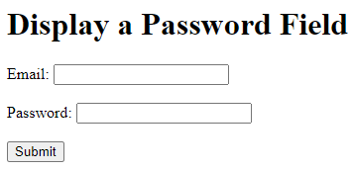
HTML <Password> Tag.
The <input type = “password”> defines a password field (characters are masked).
Example:
<h1>Display a Password Field</h1>
<form>
<label for="email">Email:</label>
<input type="email" id="email"><br><br>
<label for="pwd">Password:</label>
<input type="password" id="pwd" minlength="8"><br><br>
<input type="submit">
</form>
</body>
</html>
Output:

Slide 38
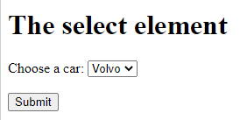
Drop-Down list
The <select> element is used to create a drop down list. The <select> element is most often used in a form, to collect user input.
Example:
Output:
<form>
<label for="cars">Choose a car:</label>
<select id="cars">
<option value="volvo">Volvo</option>
<option value="saab">Saab</option>
<option value="opel">Opel</option>
<option value="audi">Audi</option>
</select>
<input type="submit" value="Submit">
</form>

Slide 39
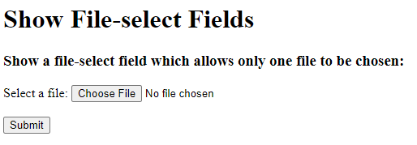
File selector dialog box
The < input type =“file”> defines a file-select field and a "Browse" button for file uploads.
Example:
Output:
body>
<h1>Show File-select Fields</h1>
<h3>Show a file-select field chosen:</h3>
<form>
<label for="myfile">Select a file:</label>
<input type="file" id="myfile"><br><br>
<input type="submit">
</form>

Slide 40
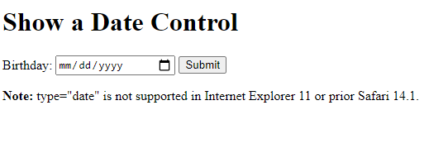
New Form Elements - DATE
The < input type =“date”> defines a date picker. The resulting value includes the year, month, and day.
Example:
<!DOCTYPE html>
<html>
<body>
<h1>Show a Date Control</h1>
<form>
<label for="birthday">Birthday:</label>
<input type="date" id="birthday">
<input type="submit">
</form>
</body>
</html>
Output:

Slide 41
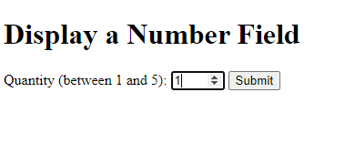
New Form Elements - NUMBER
The < input type =“number”> Define a field for entering a number (You can also set restrictions on what numbers are accepted):
Example:
<!DOCTYPE html>
<html>
<body>
<h1>Display a Number Field</h1>
<form >
<label for="quantity">Quantity (between 1 and 5):</label>
<input type="number" id="quantity" min="1" max="5">
<input type="submit">
</form>
</body>
</html>
Output:

Slide 42
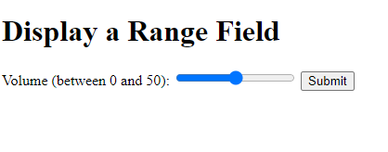
New Form Elements - RANGE
The < input type =“range”> defines a range control (like a slider control).
Example:
<html>
<body>
<h1>Display a Range Field</h1>
<form>
<label for="vol">Volume (between 0 and 50):</label>
<input type="range" id="vol" min="0" max="50">
<input type="submit">
</form>
</body>
</html>
Output:

Slide 43
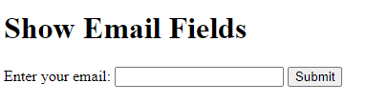
New Form Elements - EMAIL
The < input type =“email”> define a field for an e-mail address (validates automatically when submitted).
Example:
Output:
<!DOCTYPE html>
<html>
<body>
<h1>Show Email Fields</h1>
<form>
<label for="email">Enter your email:</label>
<input type="email" id="email" name="email">
<input type="submit">
</form>

Slide 44
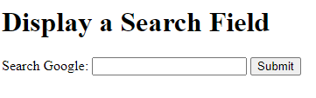
New Form Elements - SEARCH
The < input type =“search”> define a search field (like a site search, or Google search).
Example:
Output:
<html>
<body>
<h1>Display a Search Field</h1>
<form>
<label for="gsearch">Search Google:</label>
<input type="search" id="gsearch" name="gsearch">
<input type="submit">
</form>
</body>
</html>

Slide 45
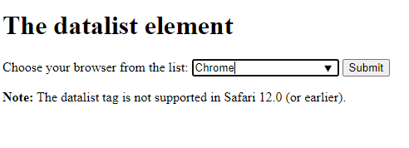
New Form Elements - DATALIST
<datalist> tag a datalist with pre-defined options (connected to an <input> element).
Example:
<form>
<label for="browser">Choose your browser from the list:</label>
<input list="browsers" name="browser" id="browser">
<datalist id="browsers">
<option value="Edge">
<option value="Firefox">
<option value="Chrome">
<option value="Opera">
<option value="Safari">
</datalist>
<input type="submit">
Output:

Slide 46
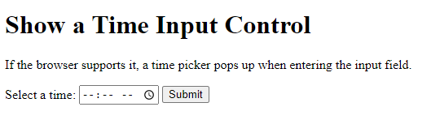
New Form Elements - TIME
<input type="time"> defines a control for entering a time.
Example:
<!DOCTYPE html>
<html>
<body>
<h1>Show a Time Input Control</h1>
<p>If the browser supports it, a time picker pops up when entering the input field.</p>
<form>
<label for="appt">Select a time:</label>
<input type="time" id="appt">
<input type="submit">
</form>
</body>
</html>
Output:

Slide 47
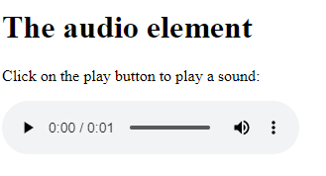
New Form Elements - AUDIO
<audio> tag is used to embed sound content in a document, such as music or other audio streams.
Example:
Output:
<!DOCTYPE html>
<html>
<body>
<h1>The audio element</h1>
<p>Click on the play button to play a sound:</p>
<audio controls>
<source src="horse.mp3" type="audio/mp3">
</audio>
</body>
</html>

Slide 48

New Form Elements - VIDEO
<video> tag is used to embed video content in a document, such as a movie clip or other video streams.
Example:
Output:
<!DOCTYPE html>
<html>
<body>
<h1>The video element</h1>
<video width="320" height="240" controls>
<source src="movie.mp4" type="video/mp4">
Your browser does not support the video tag.
</video>
</body>
</html>

